Slide 1
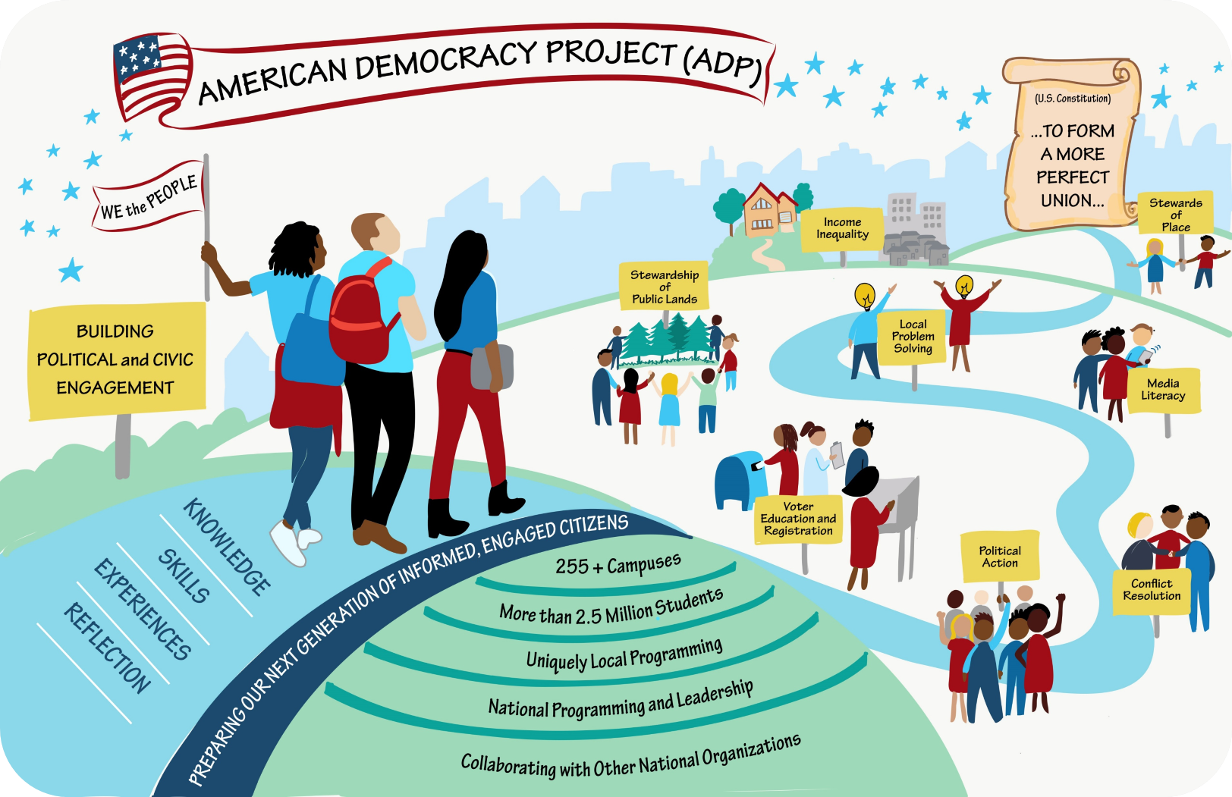
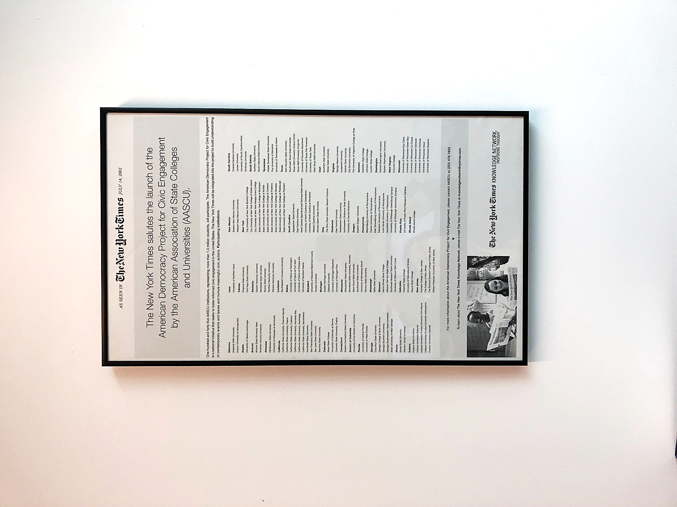
TT
The Journey Begins
Notes:
Felice to lead

Slide 2
271 ADP Campuses
Steering Committee
&
Civic Fellows
Uniquely
Local Programming
Regional & National Programming
2.7 Million Students
47 States
Online Working Groups
Equipping students with the knowledge, skills and experiences they need to be informed and engaged citizens.

Slide 3
Theory Of Change
Instilling Civic Agency
Civic Engagement as a Lifelong Practice
The Theory of Change is based on the understanding that our democratic engagement efforts are best when:
Integral: Woven into the fabric of the institution and reflected in all its activities, including research, teaching and learning in every discipline and across disciplines; student affairs programs and services; and campus cultural practices.
Relational: Involving opportunities to build authentic connections across difference, and not just complete tasks or study people and problems from a distance.
Organic: Involving unscripted opportunities to imagine, create, and grow together with partners in public work and to forge new paths.
Generative: Directed at continually improving conditions and relationships, opening up even more powerful possibilities for collective action.

Slide 4

American Democracy Project Initiatives
A Nationally Coordinated and Collaborative Approach
Voter Education and Engagement  Deliberative Dialogue Digital Polarization  Political Ideology Diagnostic  Global Challenges & Global Literacy  CLDE  Engaged Campus Institute  Citizen Professional Pathway Stewardship of Public Lands  Food Insecurity  The Census  Student Journalism

Slide 5

Education is one of the best predictors of voting behavior
Voter Education & Engagement

Slide 6
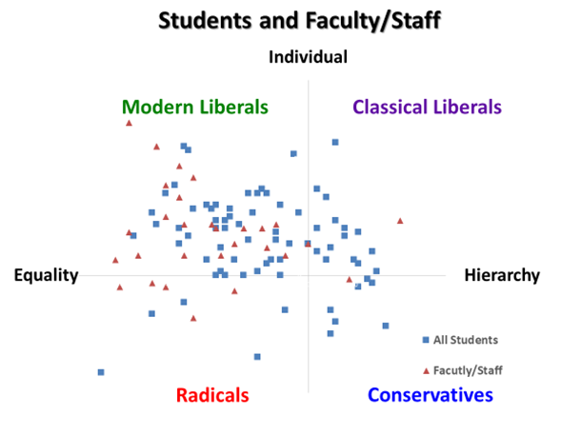
Political Ideology Diagnostic
Designed to address the polarizing stereotyping that faculty and students do about themselves and others in terms of hot-button issues.
A resource and guide to productive political discourse.

Slide 7
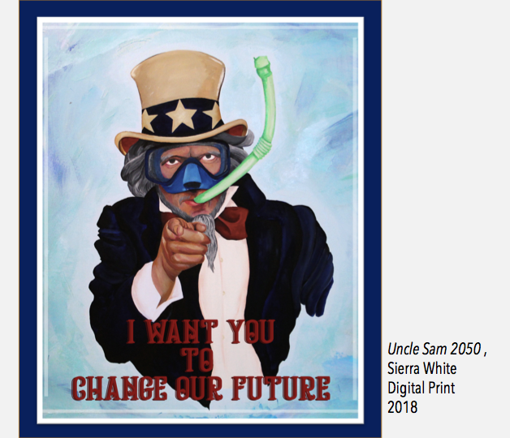
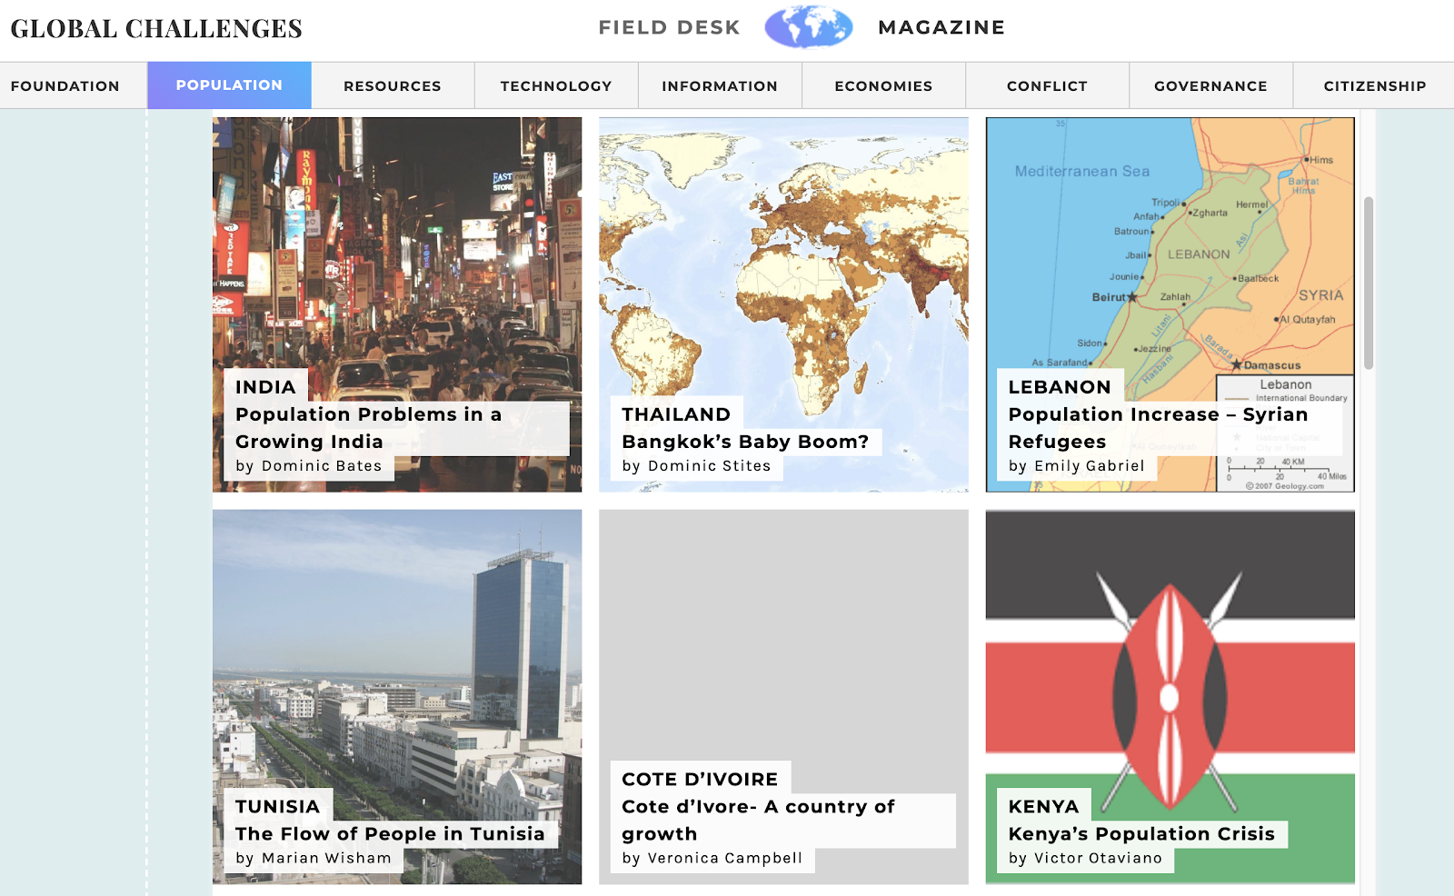

Global Challenges
Interdisciplinary course designed to provide students with knowledge and skills to be engaged, responsible and effective members of a globally interdependent society.

Slide 8
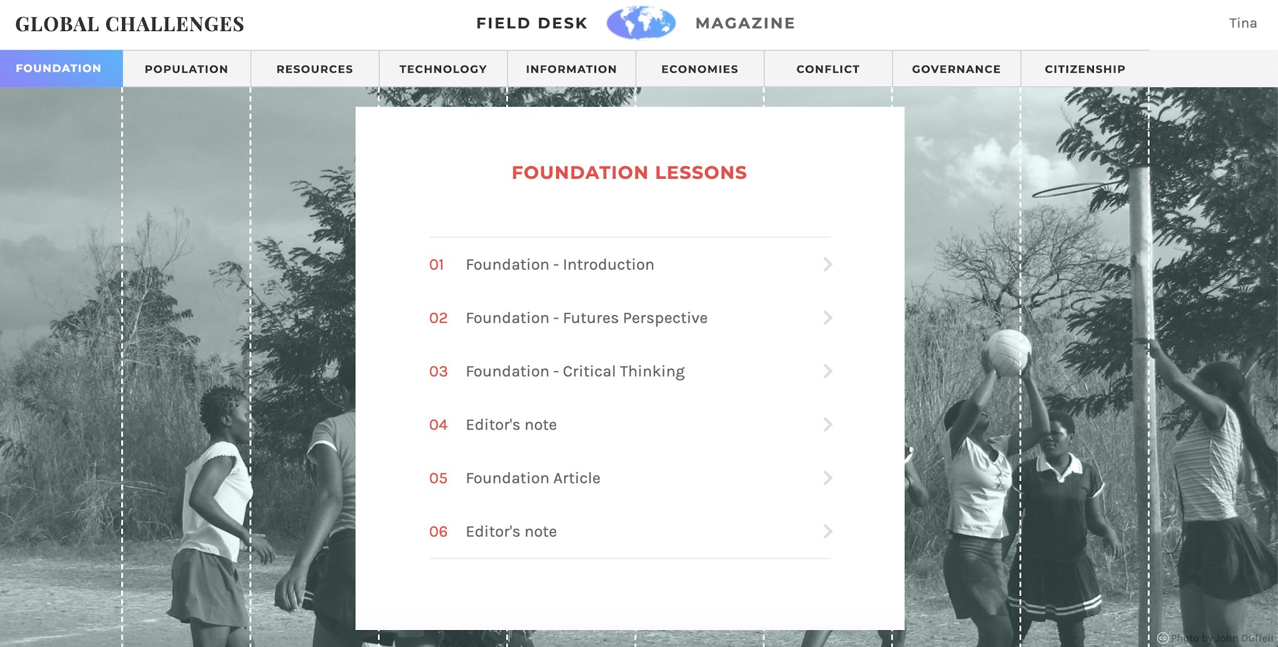

Slide 9
Global Challenges Results
More than 75% of students reported much or extensive growth in:
Deep thinking
Awareness difference
Interest and empathy for people
Critical thinking and problem solving
Ability to analyze
Media literacy
Initiative and self-direction
Provides students with the knowledge, skills and predispositions to interact effectively in a globally interdependent society

Slide 10
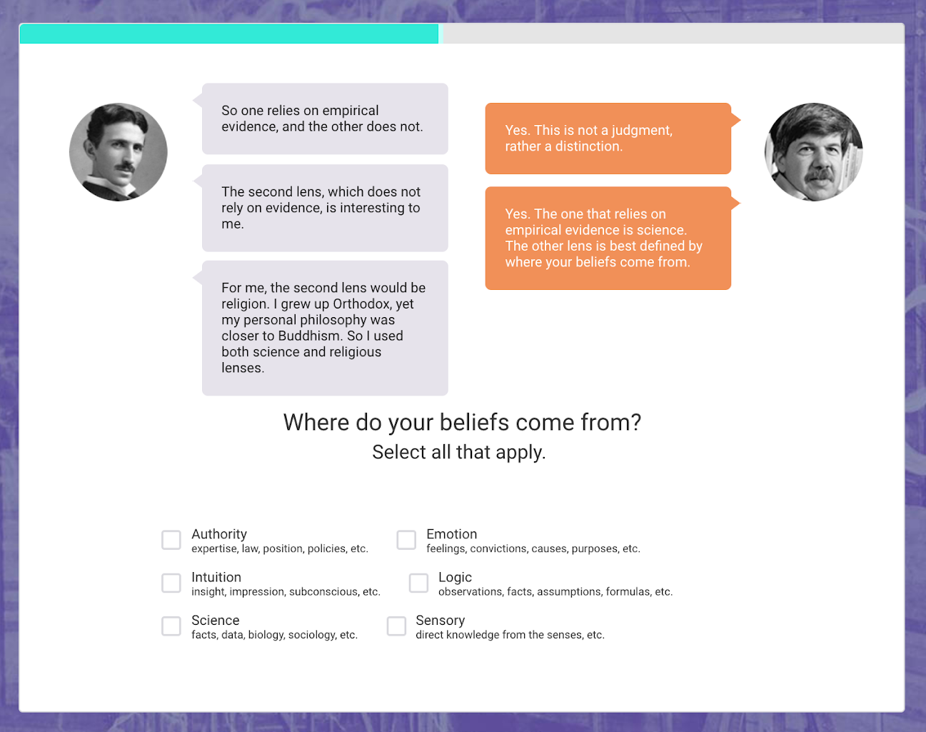
Science for Citizens
Designed to teach students the process of natural sciences to non-majors

Slide 11
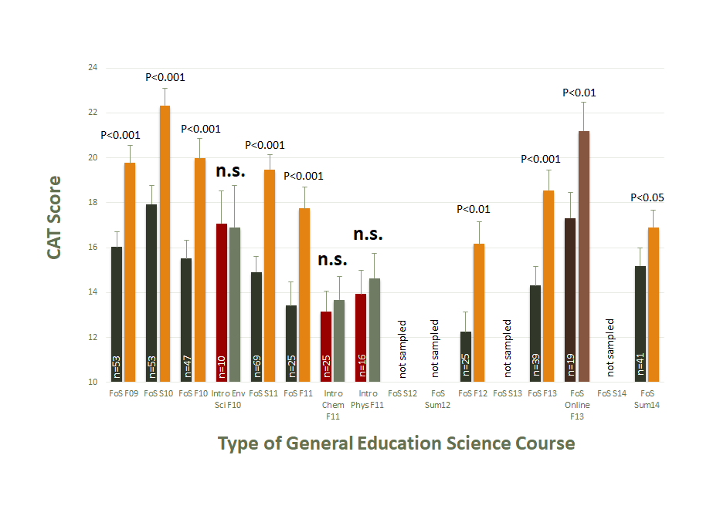
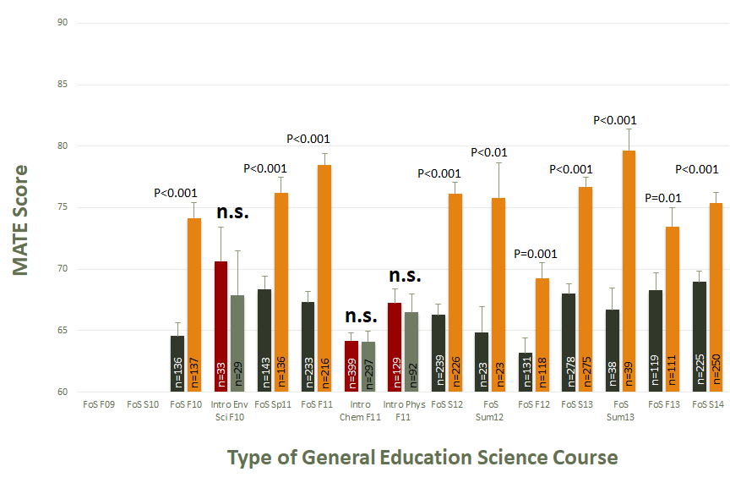
Science for Citizens Results
Critical Thinking
“Acceptance” of Evolution
Provides students with the knowledge, skills and predispositions to interact effectively in a globally interdependent society

Slide 12

SIFT
STOP
Investigate the Source
Find trusted coverage
Trace claims, quotes, and media back to the original context
Digital
Polarization (DigiPo)
Designed to help students identify fake news and misinformation
Mind Over Chatter

Slide 13
Steven Hunt, Illinois State University
Political engagement, Engaged Campus Study
Leah Murray, Weber State
Engaged Campus Study, Political Ideology
David Hoffman, University of Maryland, Baltimore County
Building a theory of change
Morgan Lewing, Texas A&M University-Central Texas
Faculty development around civic learning and engagement
Molly Kerby, Western Kentucky University
Civic assessment
Mike Caulfield, Washington State University Vancouver
Digital polarization
Civic Fellows
ADP Civic Fellows explore assessment, research
and programmatic
efforts that enact and support ADP’s mission
and national work.

Slide 14















ADP Steering Committee
Kris Pierre
Director, Career Development & Community Partnerships
David Hoffman
Director, Center for Democracy and Civic Life
Mel Netzhammer
Chancellor
Melinda Treadwell
President
Shala Mills
Assistant Vice President for Graduate and Extended Learning
Lane Perry
Director of Center for Community Engagement and Service Learning
Peg Gray-Vickrey
Provost and Vice President for Academic and Student Affairs
Robert Ducoffe
Provost and Vice Chancellor for Academic and Student Affairs
William J. McKinney
Senior Advisor for Regional Campus Affairs
Kim Schmidl-Gagne
Program Manager
Mary Evins
Research Professor
Molly Kerby
Assistant Professor for Institutional Effectiveness
Steven Koether
Foundation of Science Coordinator/Instructor
Alison McCartney
Professor, Political Science, Honors Coordinator
Eric Morrow
Interim Dean, College of Liberal and Fine Arts
Elizabeth Parmelee
Associate Vice President of Undergraduate Studies
Rebekah Selby
Assistant Professor, Mathematics and Economics

Slide 15
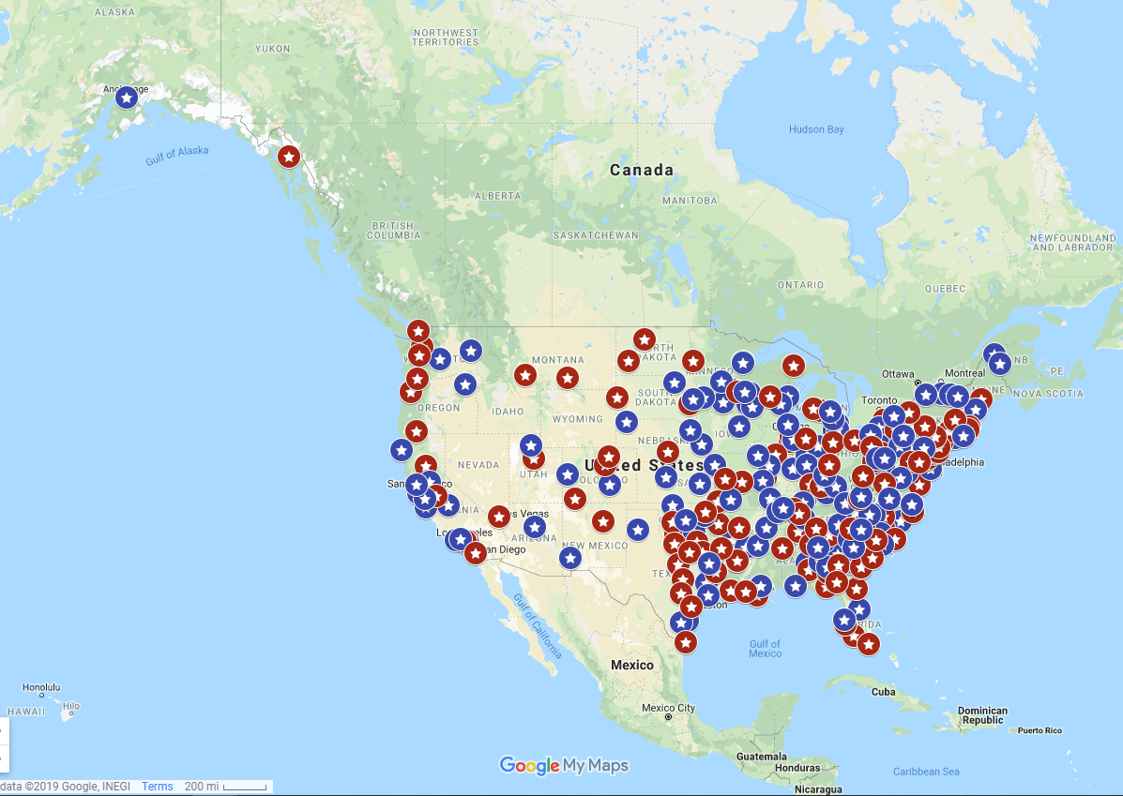





















Slide 16
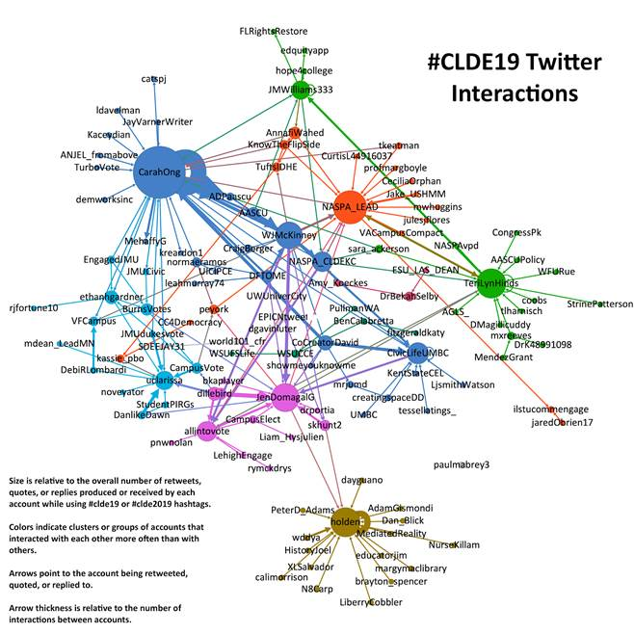
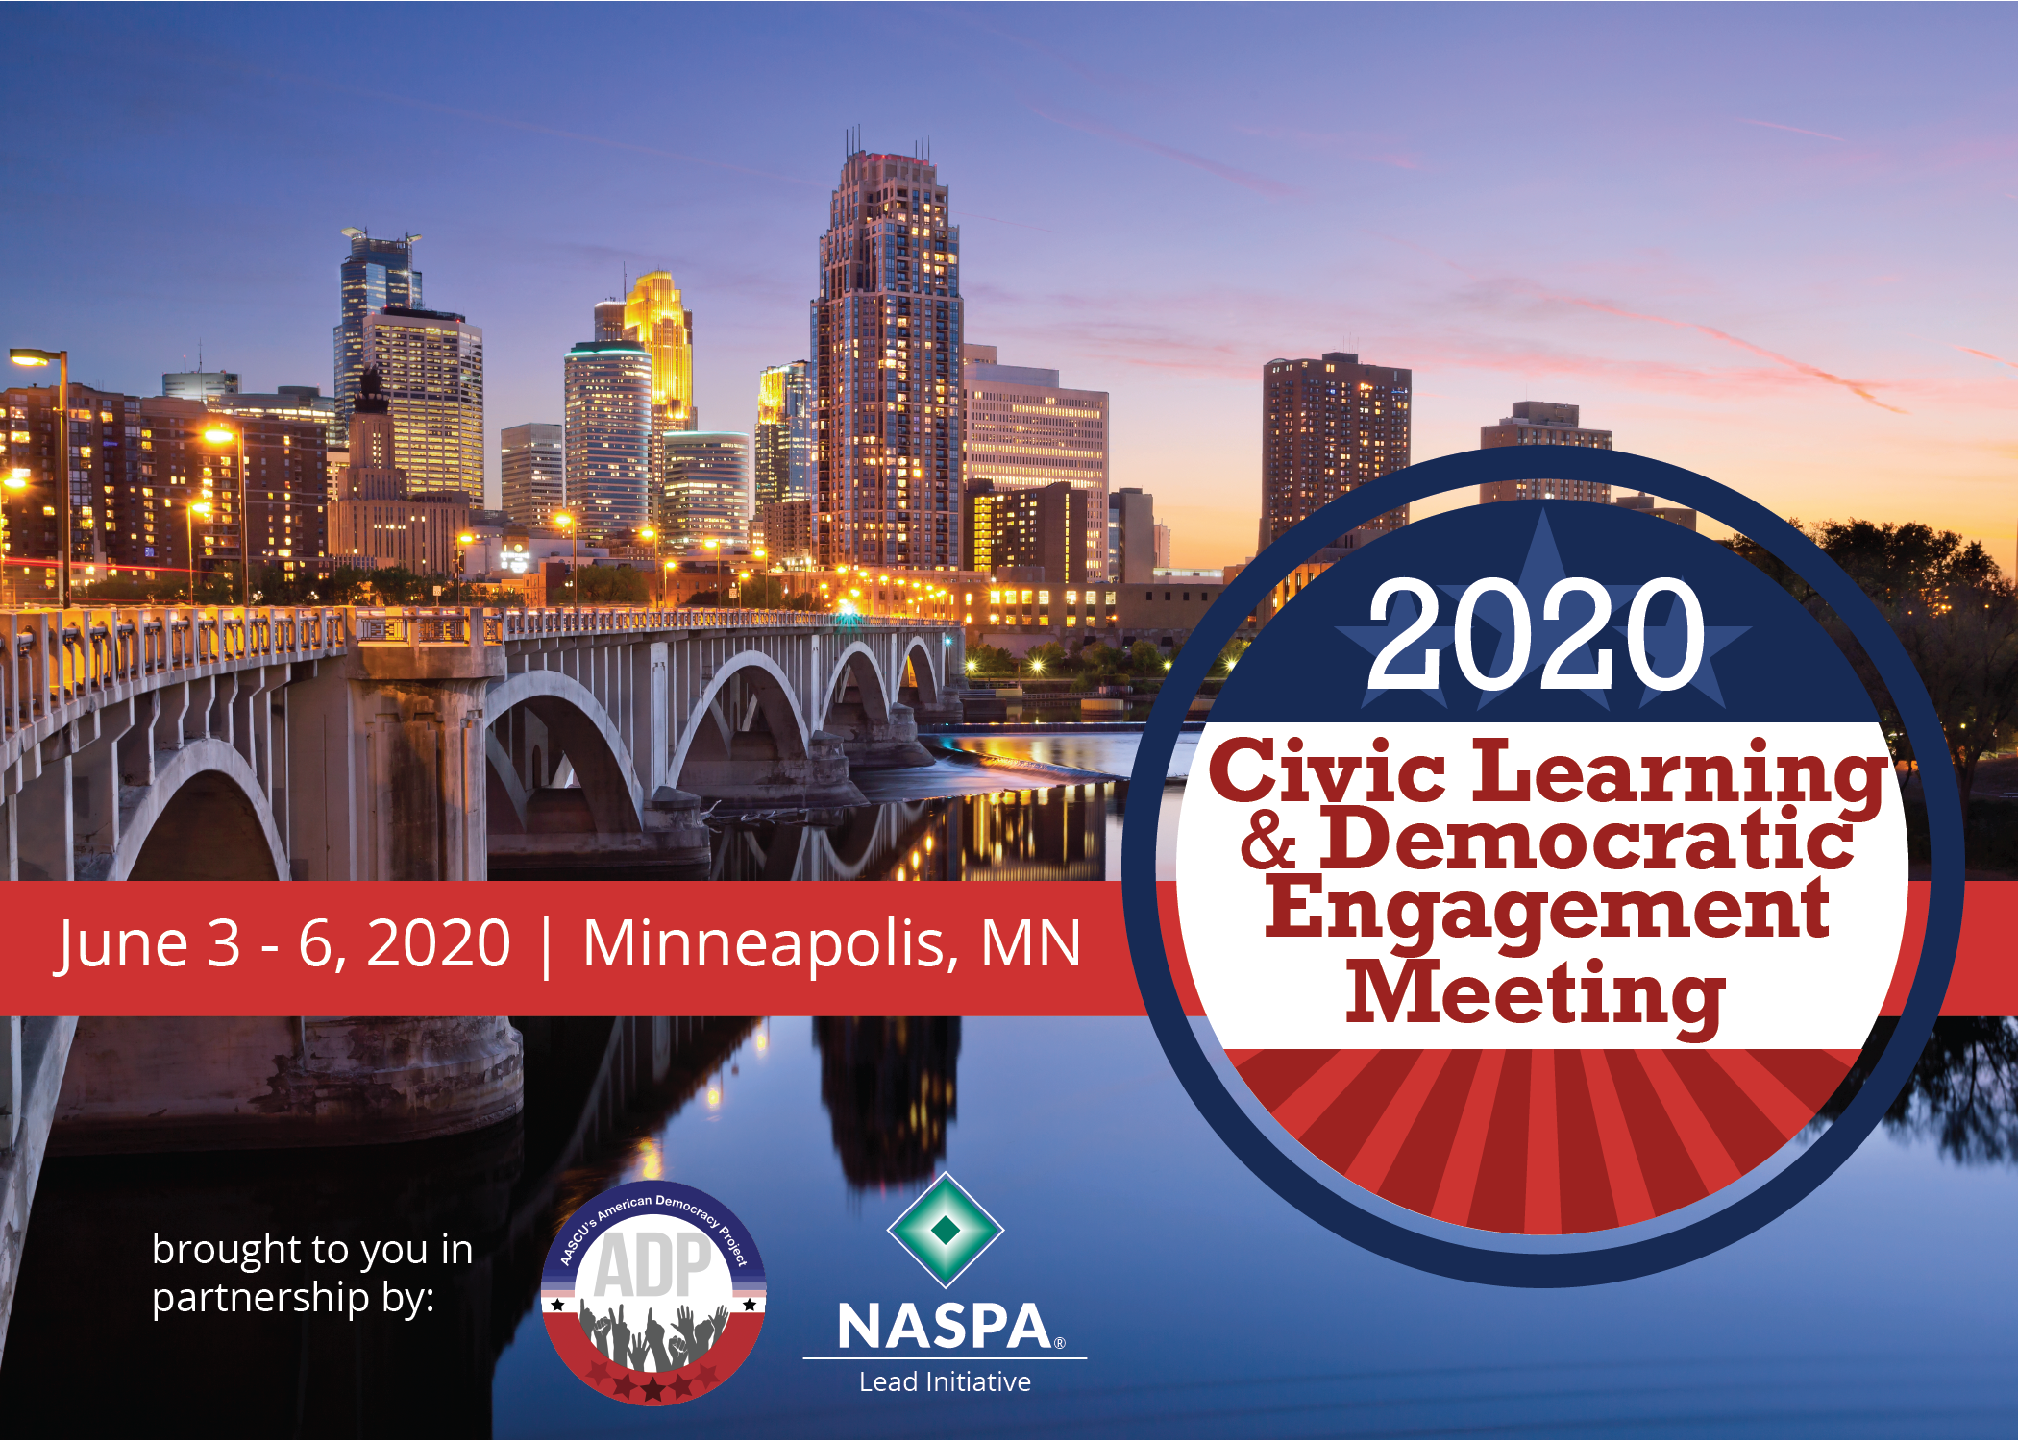
CLDE Meeting
Annual conference in partnership with NASPA
Faculty, Students, Student Affairs, Campus Leadership
AASCU, NASPA, community colleges, independents
20+ community partners and sponsors
Developed by the Social Media Analytics Command Center (SMACC) housed in the School of Communication at Illinois State University.

